Slide 1

Notes:
Joe Zack
Full stack, podcaster
front-end focused methodology for building web apps that has recently caught my attention.
Show you what the JAMstack is
Why it’s gaining popularity
What it means for web developers devs

Slide 2
I am ”Full Stack”
Notes:
Now I consider myself to be a Full Stack Developer, I like being able to work with both front-end and back-end code in order to completely solve a problem. However, I have a preference for back-end work because back-end work tends to be a bit more formal and regimented and the front-end evolves and changes so fast that it’s difficult to hang on to.
https://twitter.com/holtbt/status/977419276251430912

Slide 3
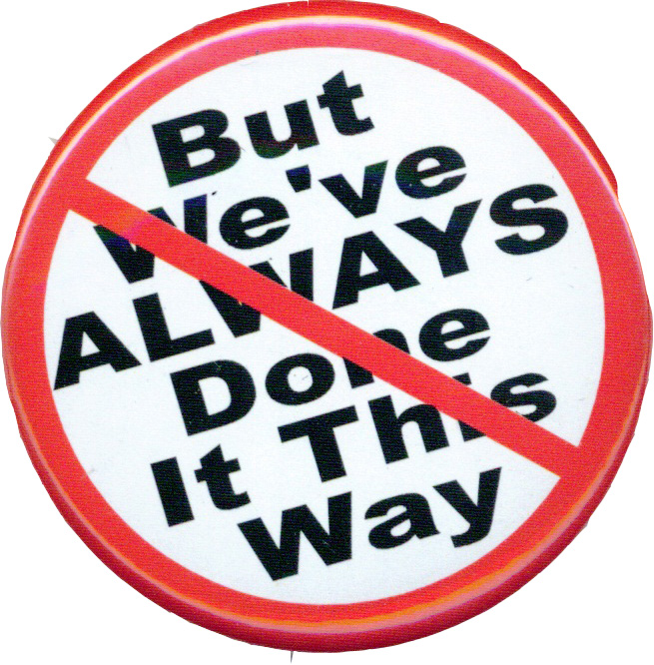
Notes:
But despite me preferences, I’m here to solve problems and I want my solutions to be the best. In order to do that, I have to pay attention to the major trends in software engineering so that I can make conscious and informed decisions about how to solve those problems.
That’s why I started researching JAMstack. I had heard that it was an interesting approach to building web apps that was changing how programmers thought about the roles of front-end and back-end coding. As a full-stack dev, the veil between those two worlds is very important to me, so I couldn’t resist checking this out.
So now I’ve built a couple small JAMstack apps now, and I’ve really liked how things have turned out and now I’m here trying to convince you to re-evaluate the roles of front and backend development.

Slide 4
JavaScript
APIs
Markup
Notes:
What is the JAMstack?
The JAMStack is a methodology for building web apps that is based on client-side JavaScript, reusable APIs, and prebuilt Markup and it’s gaining popularity at the expense of some existing, entrenched technologies.
JavaScript
Client-Side JS
Framework agnostic
Build time rendering
Auth is handled outside the app, with API
APIs
All server-side processes or persistence are abstracted into APIs
All APIs are accessed over HTTPS from the JS
Treat your own server-side components as 3p
Plays nice with Microservices
Markup
Templated markup should be prebuilt at deploy time
Usually using a site generator or build tool
Separates your content from your look n feel
------
What is the JAMstack?
The JAMStack is a methodology for building web apps that is based on client-side JavaScript, reusable APIs, and prebuilt Markup JAM
JavaScript
Client-Side JS – no prescribed framework – can even be vanillaJS
Many of the modern front-end frameworks like React or Angular have a server-side build component – and that’s fine, but the output of that build process needs to be Client-side website that you can publish as a static site
APIs
Any server-side processes or persistence you need are abstracted into APIs that are called from your js – either at run time or even better at build time
Even server-side code that you owns needs to be treated as if it were a 3p service
Markup
The idea here is to keep your content decoupled content from your design
Talking about JAMstack it’s common for devs to use site generator or build tool to pull content from flat files or APIs
That’s fine, it’s not cheating – as long as you can publish the output as a static website

Slide 5
JAVASCRIPT
API
Markup
Notes:
Ok, so JavaScript, APIs and Markup
That just kinda sounds like a basic website
If anything, sounds like a step back in time to when dinosaurs like Geocities ruled the internet
But just bear with me a little longer so that we can talk about the benefits of build-time rendering

Slide 6
Best Practices
Static Website
CDN Hosting
Modern Build Tools
Single Git Repository
Atomic Deploys
Instant Cache Invalidation
Notes:
Where does the stack part come in?
Stack:
Misleading (MEAN, LAMP, Microsoft)
(Combination of complimentary technologies)
Have their own part to play and the result is greater than the sum of it’s parts
JAMstack is ambiguous
JAMstack is more of a methodology
Best practices that jive well with JAM
The app should be distributed on a CDN, the more on the edges, the better the UX
Modern Build Tools: Babel, WebPack, Gatsby, etc
Everything you need to run the app lives in a single git repository - simple npm install
Remember FTPing? Watchers more common now
Focus on automated builds, there is less emphasis on persistance, so changes generally need to be deployed
Atomic deploys (deploy everything at once instead of file by file)
Instant cache invalidation (use a CDN that can handle instant cache purges)
-----------------
So, we’ve talked about the JAM – but where does the stack come in?
Well… there kinda isn’t one.
When I think of a technology stack I think of a combination of complimentary technologies that work well together: Things like LAMP stack or MEAN, or Microsoft stack
JAMstack isn’t so rigidly defined, it’s much less prescriptive. It’s really just a set of best practices for building decoupled front-end websites, with a heavy emphasis on build-time rendering
I’ve got a list of best-practices up on the screen here, but all of these best-practices really revolve around those two core concepts:

Slide 7
Best Practices
Static Website
CDN Hosting
Modern Build Tools
Single Git Repository
Atomic Deploys
Instant Cache Invalidation
Decoupled front end
Build Time Rendering
Notes:
Deploying Decoupled static websites that can be hosted on a CDN, and Build-Time Rendering

Slide 8
Rendering
Write
Server
Client
Build
Notes:
When I say “Build Time” rendering, I’m talking about fetching all the data that you can when you are building your application for deployment. I’m talking about querying your db, services, or filesystem up front.
This works great when you have data that doesn’t change often, take for instance a content heavy site where posts are often published once but read bazillions of times…like Wordpress
Static site generators really shine at this, and traditional front-end frameworks like Angular and React are pushing towards this frontier with things like Angular AOT, React Pre-Pack

Slide 9
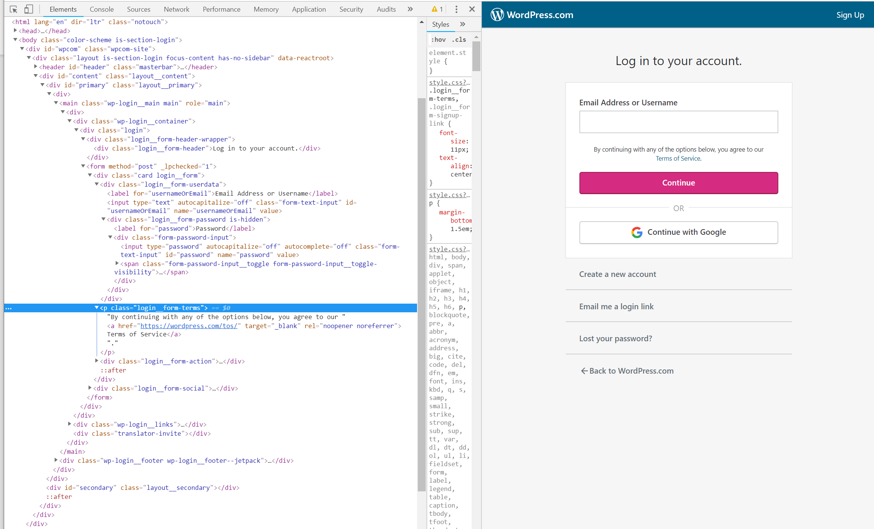

Write
Notes:
Your browser takes html code, and turns it into something easier for humans to interact with.
You can write html by hand, but it’s slow and tedious. Also, things like headers and footers may appear on more than one page so maintaining those files by hand is a real nightmare.

Slide 10
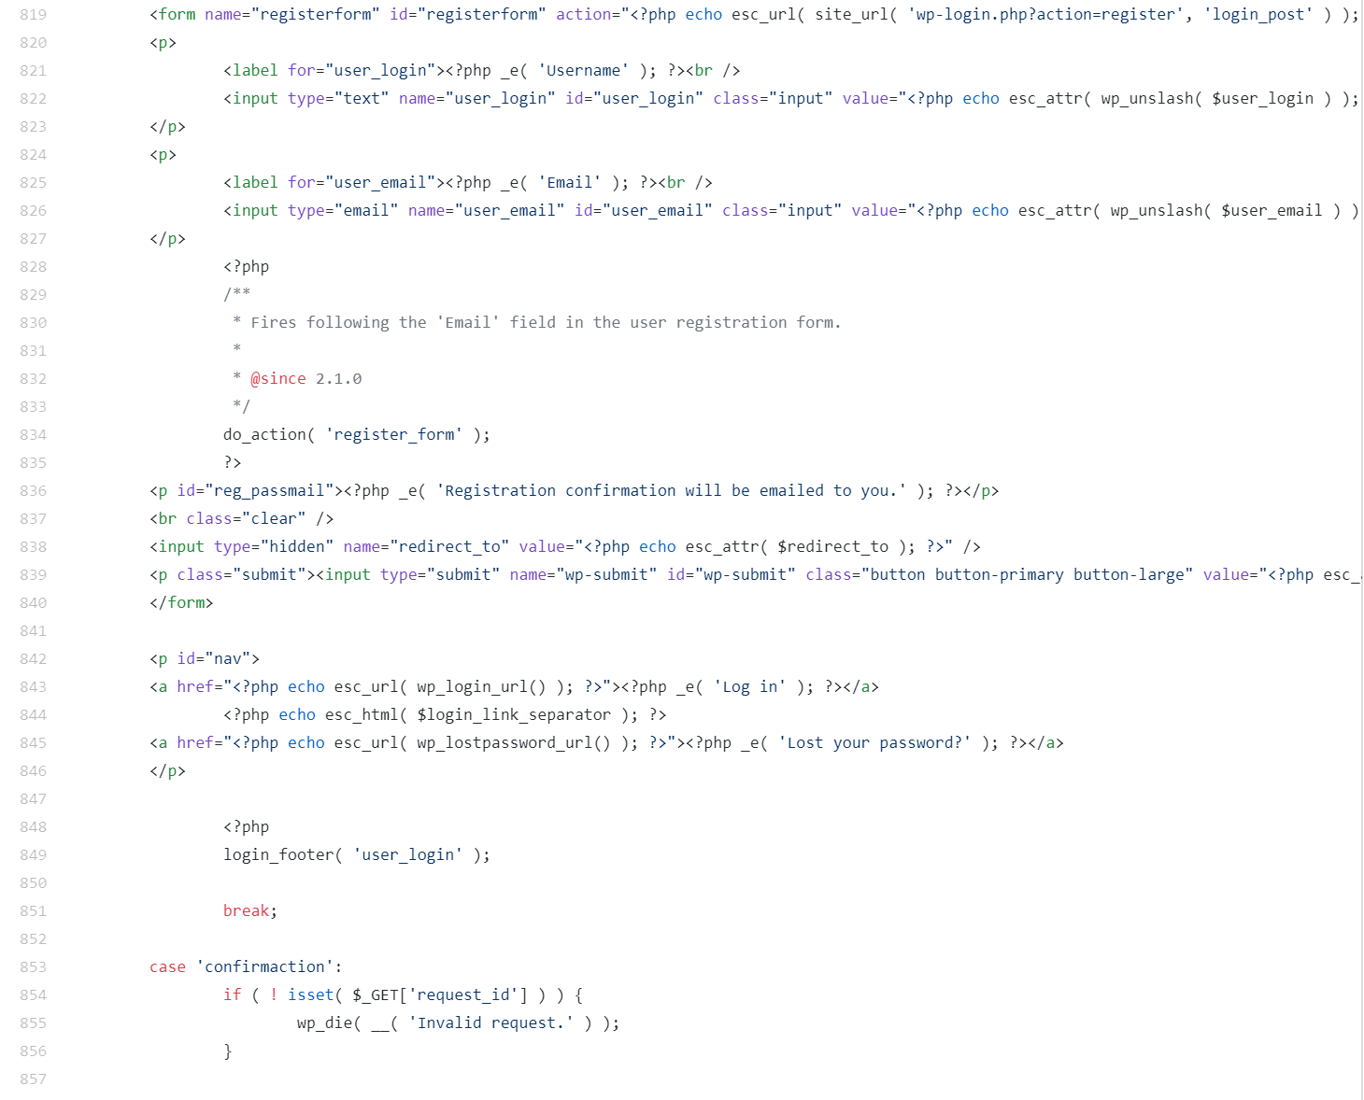

Server
Notes:
Here’s a snippet of the php code for rendering the login form from the previous slide at server time,
Wordpress uses PHP to dynamically generate html whenever it’s requested by the browser.
This code runs every time you go to the login page in Wordress.
This buys you a lot of flexibility, but you are doing a lot of repeated work whenever a user hits the page.
Additionally, you now have to worry about the performance, and security of PHP servers.

Slide 11
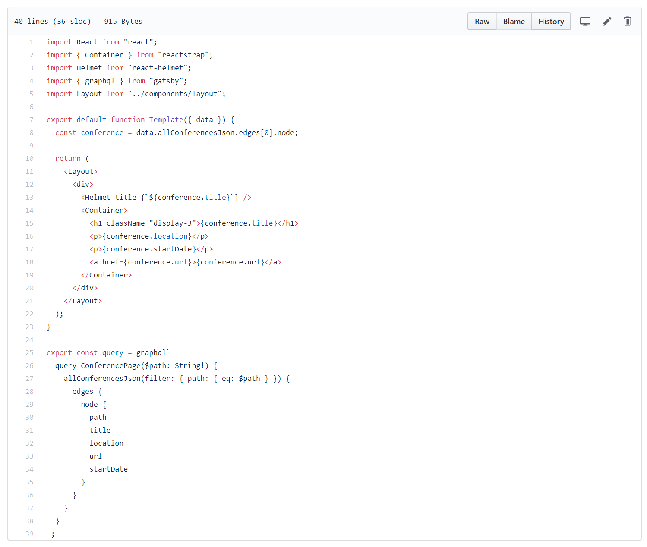

Client
Notes:
Client side rendering is a step up, it decouples the design of your website from the logic.
Your web site can be hosted separately from any application server or servers. This is a nice fit with microservices.
This is a snippet from a Gatsby site, and when I’m running in Gatsby development mode this GraphQl query is run and the data is used to dynamically update the browser’s copy of the html.

Slide 12

Build
Notes:
When I publish the Gatsby site, however, Gatsby will execute all the permutations of this graphql and render the data as json files which can be requested by the browser as needed.
You can go one step further and generate a full html file if you want, but it’s generally more efficient to just have the browser grab the boilerplate once and change the bits that need to change as the user browses around.

Slide 13
Types of Rendering
Write
Server
Client
Build
Build Time
is
Best Time
Notes:
If you can that work up front, then that means you only have to do that work once.

Slide 14
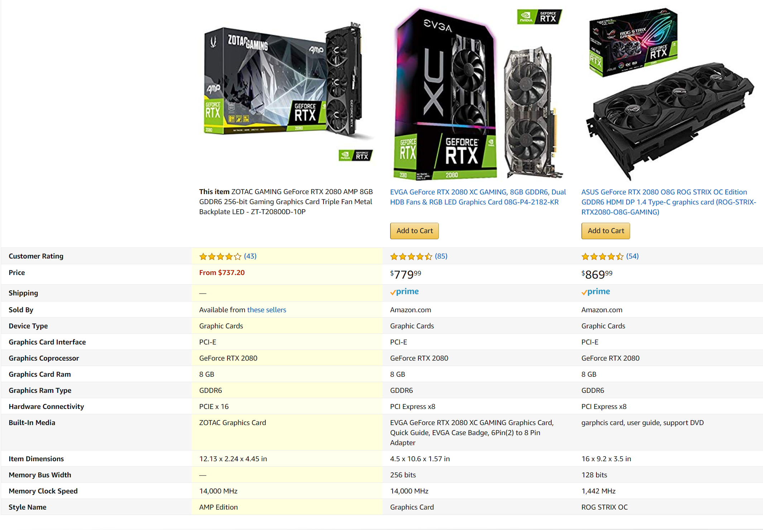
Notes:
But what if your data does change often?
Most “data” doesn’t change often, or at all. But some does, some data just needs to be real time.
There is nothing wrong with that, you just won’t be able to leverage the benefits of build-time rendering for those data points
If your application relies heavily on real-time data, then it’s probably not a great candidate for JAMstack.

Slide 15
Notes:
However, many applications only need a small percentage of their data in real-time.
There is nothing wrong with fetching the data you need in real-time, and you can still leverage build-time rendering for the data that doesn’t change as often.
E-Commerce webapps are actually a common use case for JAMstack applications, you just fetch the real-time data you need at run time.
Blogs and CMS are also common use cases, you just fetch the comments real-time.

Slide 16
Location Matters
Notes:
One of the biggest benefits of build time rendering is that you can publish your results to a Content Delivery Network (aka CDN)
This means that people all over the world can access copies of your static files from locations that are physical closer to them.
Without a CDN, your data has to travel a lot farther.

Slide 17
Content Delivery Networks
Notes:
CDN’s mean faster load times for your user, and they are also highly resilient and offer great protection against denial-of-service attacks.

Slide 18
CDN Hosting: The Best Hosting
performance
Security
Pricing
Scalability
Notes:
Static hosting on CDN is tough to beat
The only way to beat CDN hosting, is no hosting
Performance
Scalability
Security
Pricing
Great for devs, great for users
Perfect for side projects, cheap or free
Google loves it because it’s fast and it jives nicely with Progressive Web Apps

Slide 19
Best Practices
Static Website
CDN Hosting
Modern Build Tools
Single Git Repository
Atomic Deploys
Instant Cache Invalidation
Decoupled front end
Build Time Rendering
Notes:
That’s what JAMstack is, a set of best practices for building decoupled front-ends with a heavy emphasis on build-time rendering.
It gives us a name to refer to a subset of static sites, that have these particular features and benefits.

Slide 20
JAVASCRIPT
API
Markup
Notes:
Yeah, ok, so Build-Time rendering is nice and CDN hosting is fantastic but neither of these are new concepts.
Why are we having this talk in 2019?

Slide 21
Why now?
Proliferation of Managed Services
Netlify
GitHub
LetsEncrypt
Contently
Great tooling
React
Vue
Gatsby
Hugo
Notes:
We’ve hit critical mass
JAMstack works because the tools and cloudy services we use to build apps have multiplied and matured so that web developers can focus less on the boring things that we expect from all web apps, like performance, scalability, security, https
And we get to spend more energy on our problem domain – the things that make our solutions unique.
This makes us more efficient, and it frees us up to be more creative.

Slide 22
Why now?
Critical Mass
Managed Services
Great Tooling
Proliferation of Managed Services
Netlify
GitHub
LetsEncrypt
Contently
Great tooling
React
Vue
Gatsby
Hugo

Slide 23
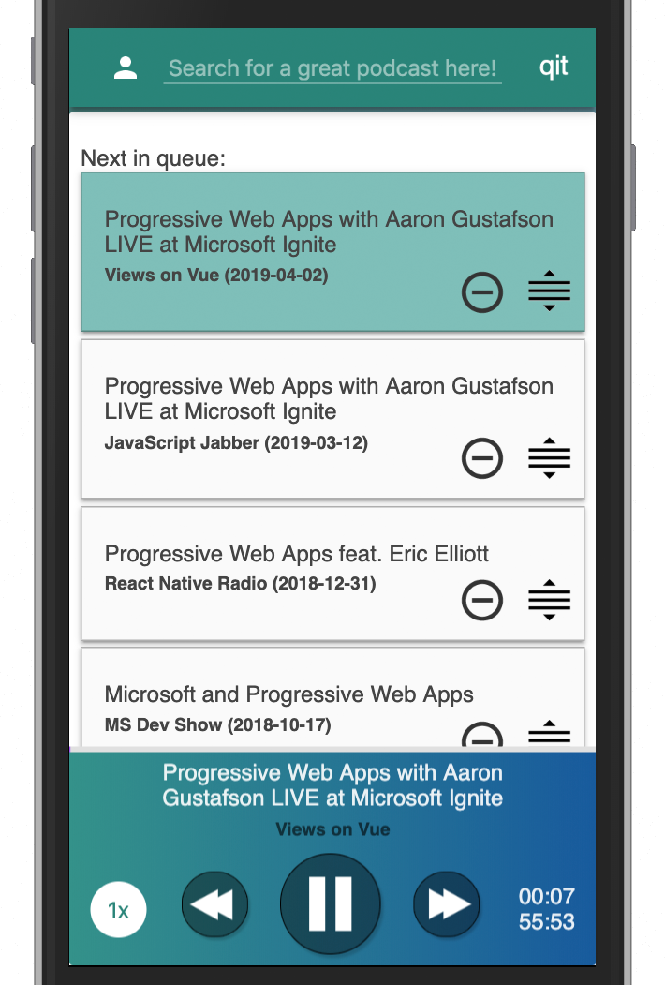
Progressive Web Apps
Installable sites
Work without internet
Push notifications
Microsoft + Google Play Store

Slide 24

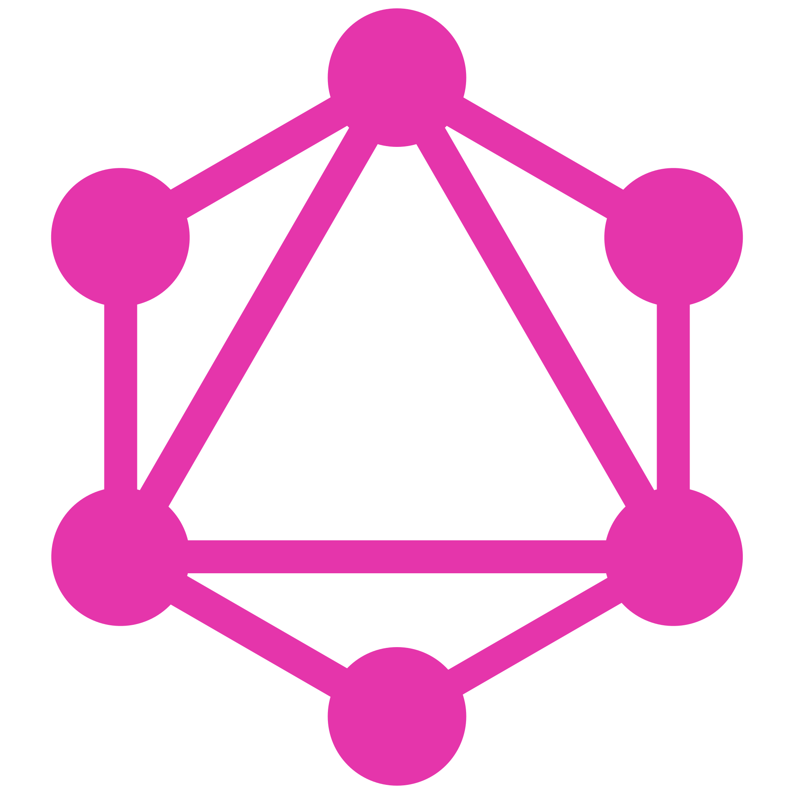

Notes:
Lets take a quick peek at how these some of these tools and services can fit together.
JAMstack doesn’t require any of these tools or services, this just happens to be my preference for building static sites.
In this example
I’m using Gatsby as my static site generator
React (Server Side Includes, Templating)
Rich plugins ecosystem for ETL
GraphQL (API/Isolation Layer Between my Design and Data)
Netlify acts my continuous integration and deployment pipeline, as well as my CDN
It uses LetsEncrypt for https, basically just a checkbox for me
Host in GitHub

Slide 25
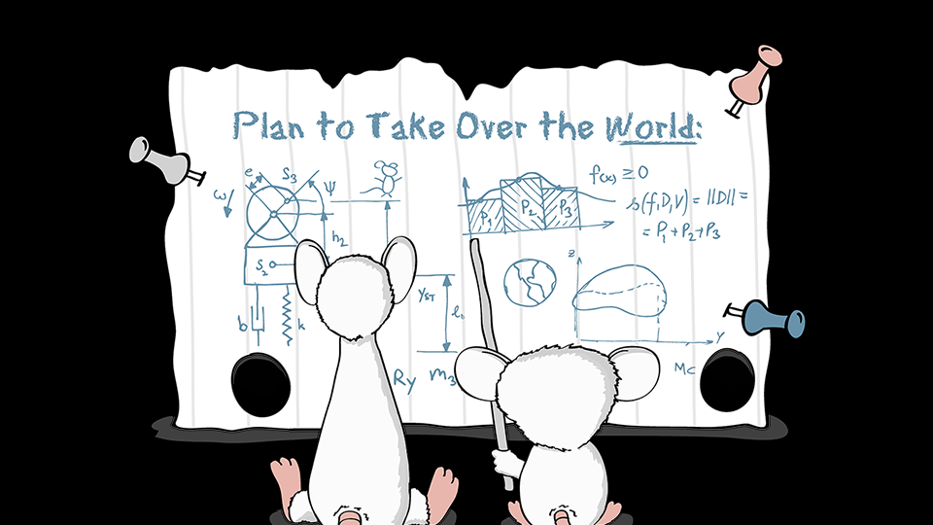
Notes:
Onto the code!

Slide 26
Downsides?
Secret Management
Non Developer Interactions
Real-Time Systems
Notes:
I don’t think that JAMstack is the answer for everything, but I do think that decoupled websites hosted on a CDN hosting should be the default choice when building a new web app.
Here are a couple use cases I came up with
Scales great for users...but how do large projects scale for devs?
Steep learning curve for non-devs
Real-Time Data
Help from the audience!
Same downsides as a SPA

Slide 27





What value does the back-end provide?
Notes:
This is the most important screen in the whole presentation.
I don't know if we'll be talking about "JAMstack" in a few years, but I do think that we will see the front-end pushing more and more towards build time rendering.
This is an important trend for Back-End devs to watch, because build-time rendering changes the responsibilities of the back-end. You no longer need a back-end framework for server-side rendering. This can now be done better in the front-end, at build time. Why shouldn’t the front-end own the all of the html rendering? It’s closer to the browser, closer to the user, and it’s good at it.
The back-end is losing ground here, it is responsibilities to the front-end. I’m betting that the concepts behind JAMstack will continue to gain popularity. That popularity will be taken from the mature, entrenched technologies you see on this screen.
However, I’m arguing that this is a good thing.
If the back-end devs give up on server-side rendering. This completely frees the back-end up from front-end concerns. The back-end can now wholly focus on everything from the API layer down.

Slide 28
The future of back-end work?

Slide 29
Notes:
Researching the JAMstack has changed how I view the roles of front-end and back-end coding. It has changed how I’m investing my development time now.
I no longer care as much if (for example) php has a better rendering experience than Flask. I’m going to favor the tools that make for better APIs

Slide 30
Notes:
- JAMstack is a set of best practices for building decoupled front-ends with a heavy emphasis on build-time rendering
- It’s quickly gaining popularity because the managed services and front-end tooling have reached a tipping point where it’s now easy to make great static sites at build time
- I am betting that Front-End and Back-End responsibilities are changing to focus on build-time rendering and APIs

Slide 31
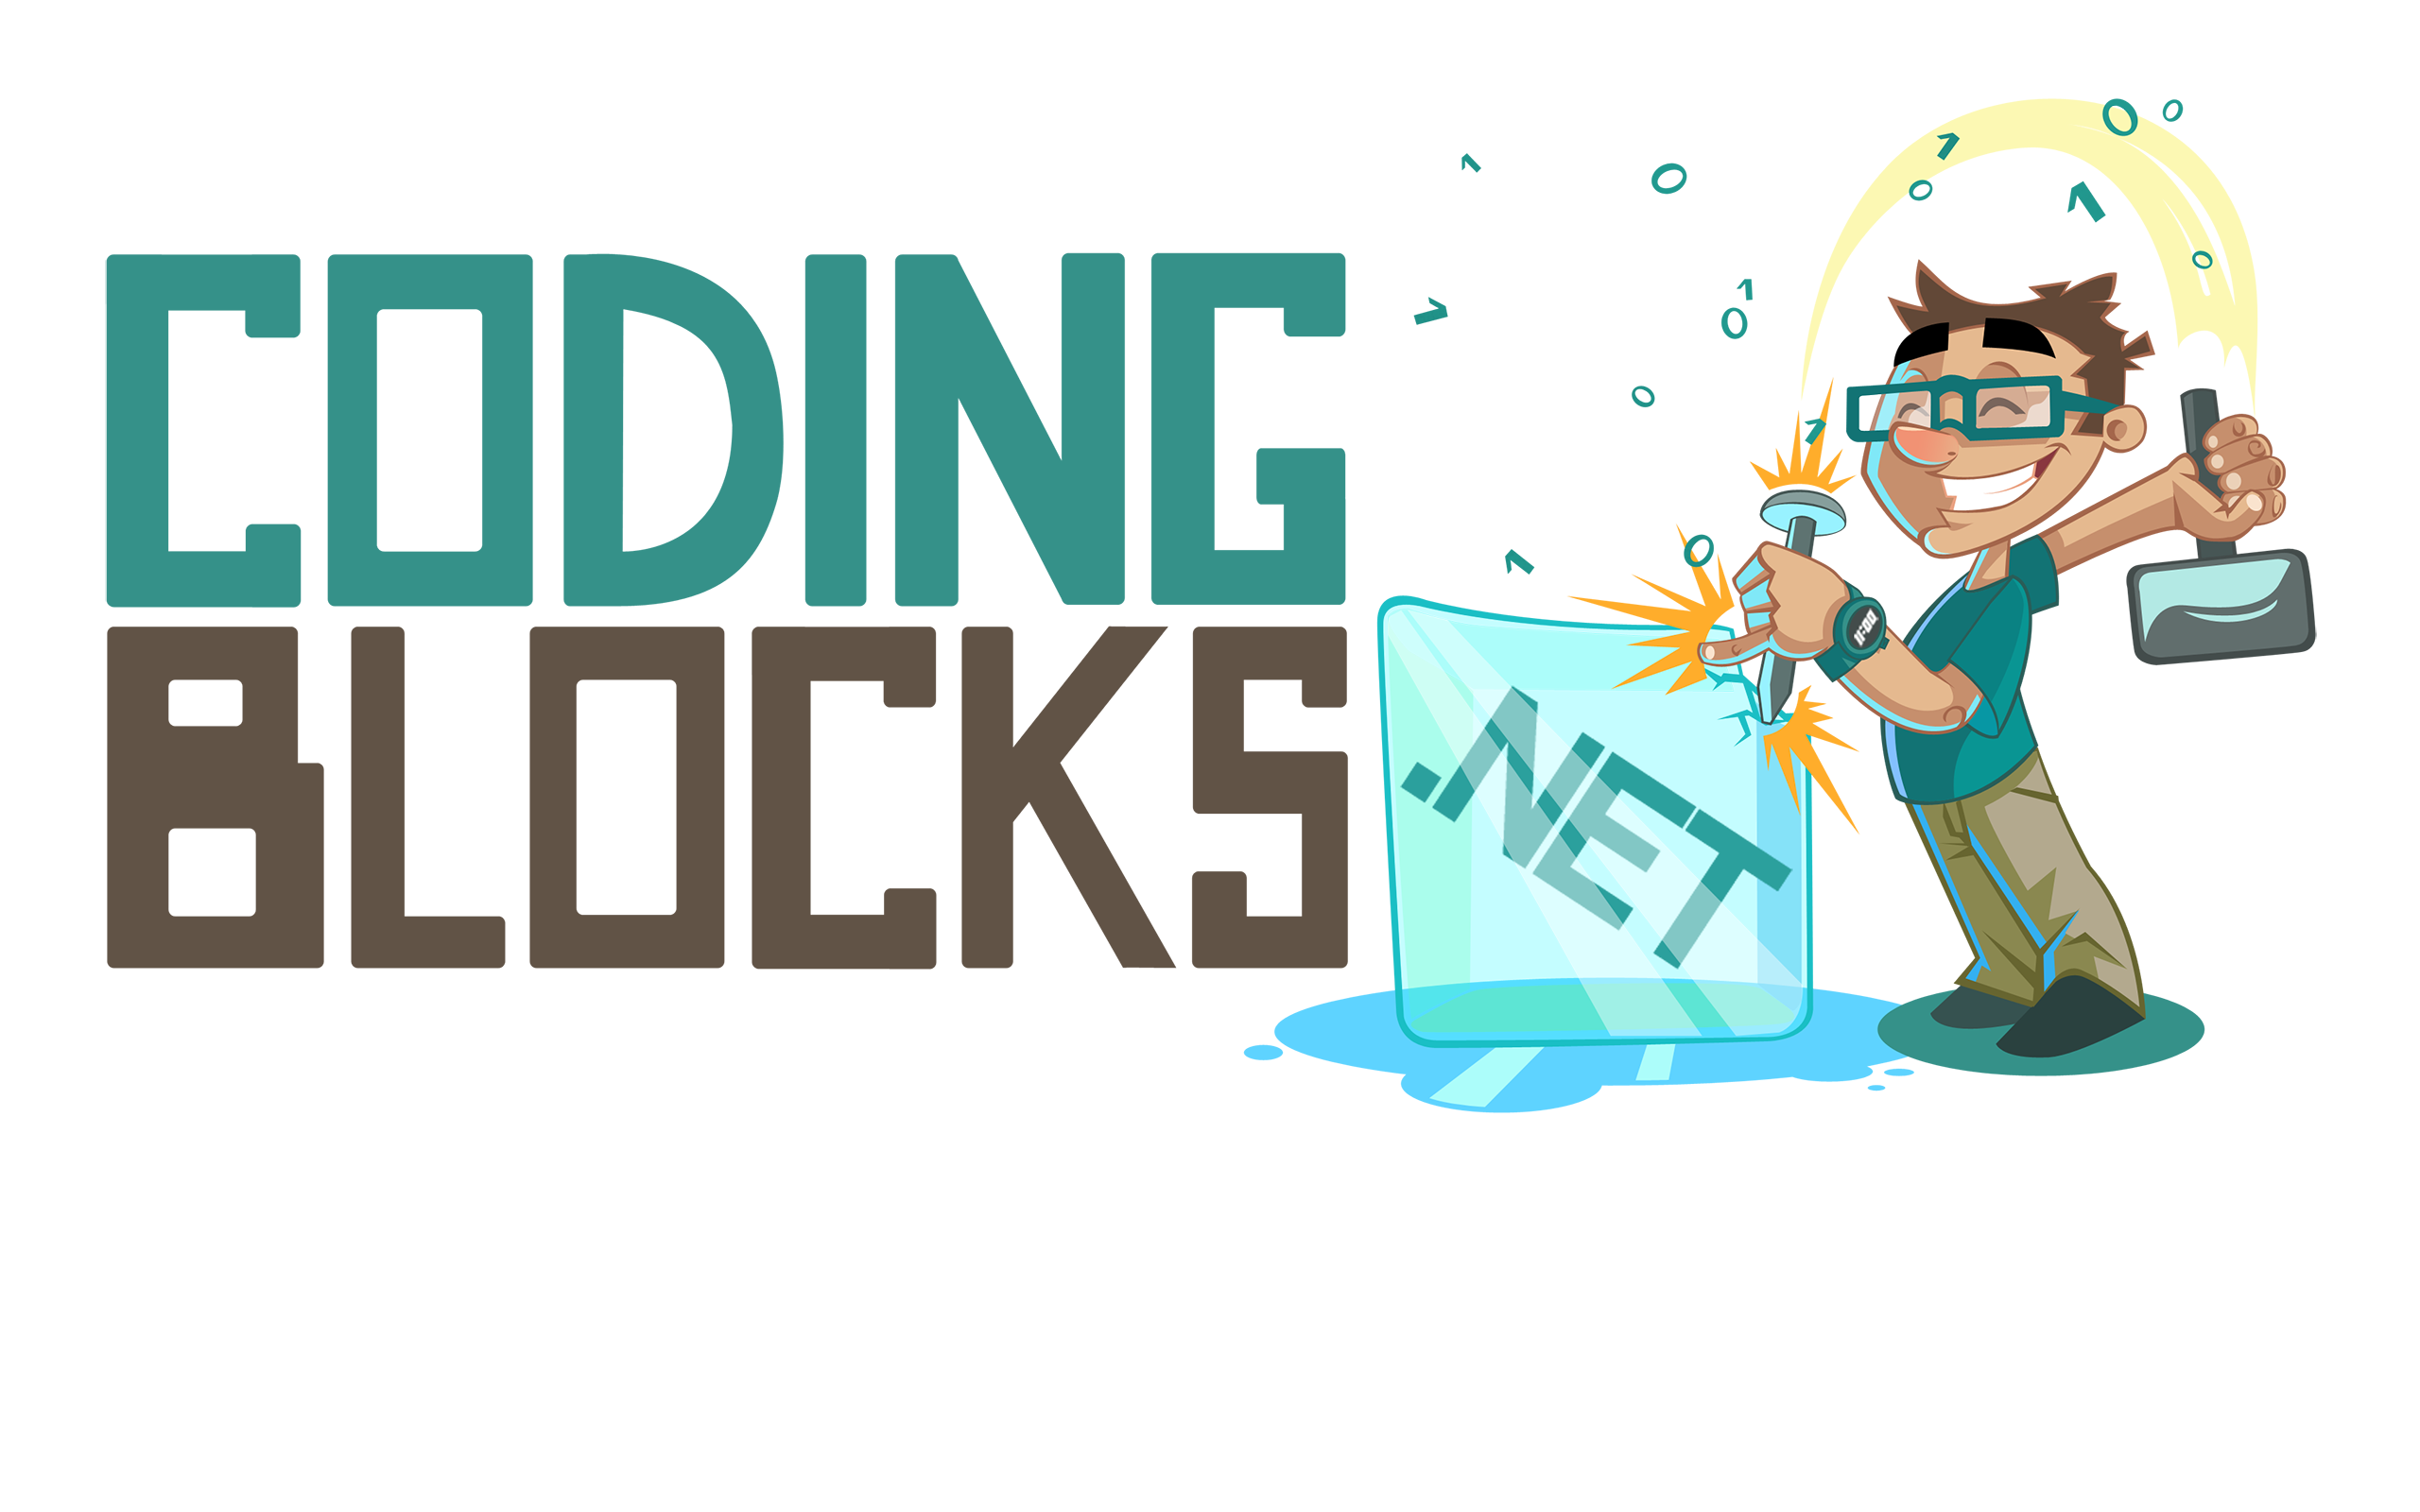
Like this talk? Check out the show!
Joe Zack
@codingblocks
github.com/codingblocks
Notes:
If you like this kind of talk, check out the Coding Blocks podcast or github, YouTubez, whatever
We don’t do guest interviews, we try to focus on “real” dev talk, like how front-end and back-end roles are changing.
This talk is up on github along with some recommended links.

